Slide 1
AUTOMATED STUDENT ATTENDANCE
SYSTEM USING FACE RECOGNITION
Submitted by
Md. Nazmul Hossain
ID: 1744CSE00630
Supervised by
Sohaib Abdullah
Assistant Professor
Dept. of CSE,Manarat International University
Manarat International University
<number>

Slide 2
Outline
Definition
Why do we need face recognition based attendance system?
Proposed Model
Tools
Conclusion & future work
Manarat International University
2

Slide 3

Definition
Facial recognition is a way of identifying or confirming an individual’s identity using their face. Facial recognition systems can be used to identify people in photos, videos, or in real-time
Face recognition based Student attendance system is marking of attendance based on this technology.
Manarat International University
3

Slide 4
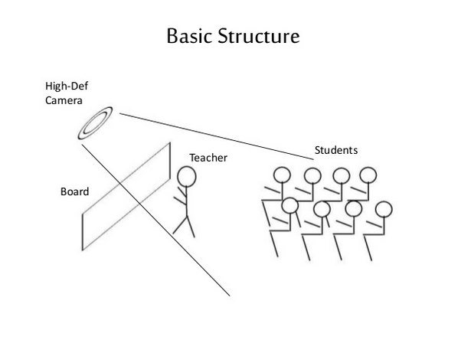
Manarat International University
4

Slide 5
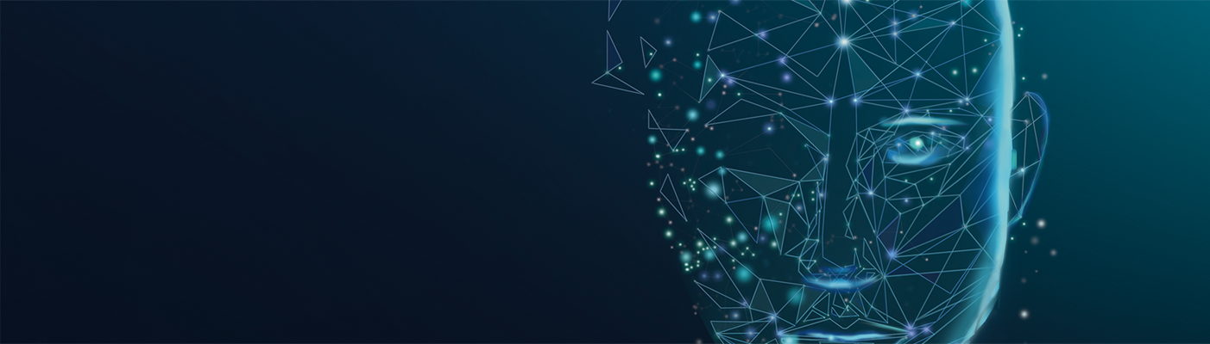
The Need
Reduce waste of time
It will increase the productive time of the class
Proxies will put an end
The hassle of carrying paper will be cut off
Manarat International University
5

Slide 6
Tools
Python
Pandas
OpenCv
Numpy
Face_recognition
Manarat International University
6
Notes:
<number>

Slide 7
Face recognition library
MTCNN is a neural network which detects faces and facial landmarks on images.
MTCNN works with three stages.
Find the location.
Find the encodings.
Compare the encodings.
Manarat International University
7
Notes:
<number>

Slide 8
Proposed Model
Students information
Read the class from Routine
Find the encodings of the students
Capture image of classroom
Recognize the face
Find the encodings of captured faces
Mark attendance
Manarat International University
8

Slide 9
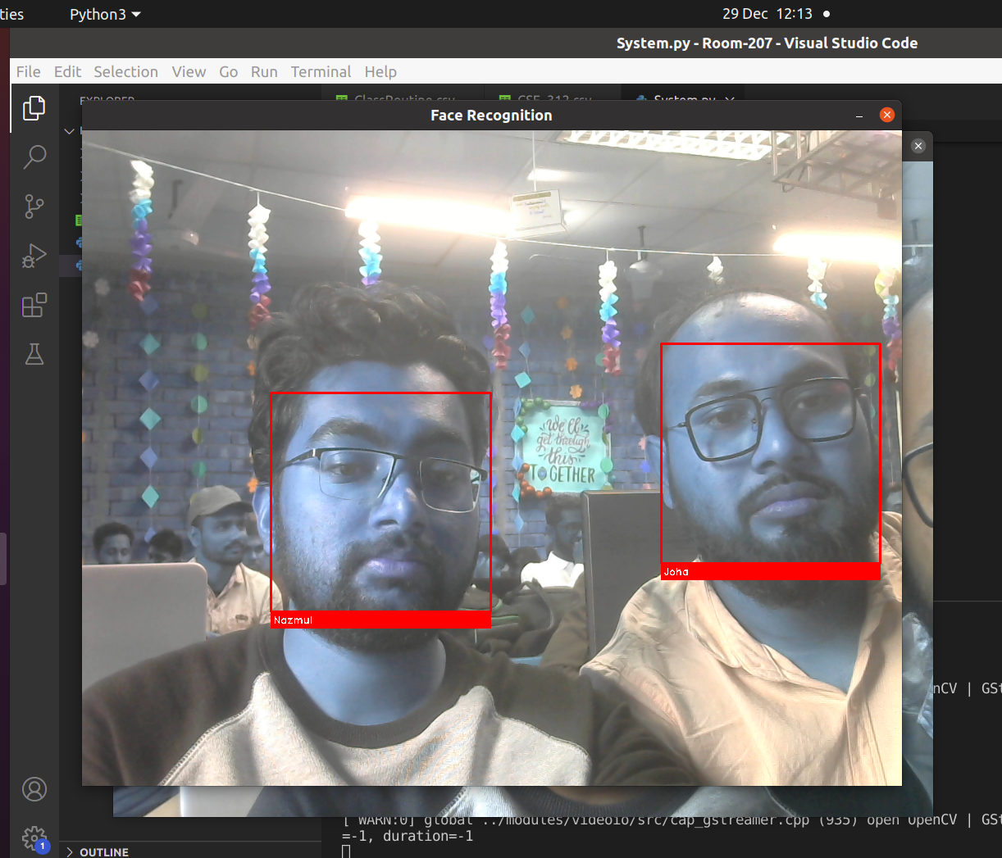
Demo

Slide 10
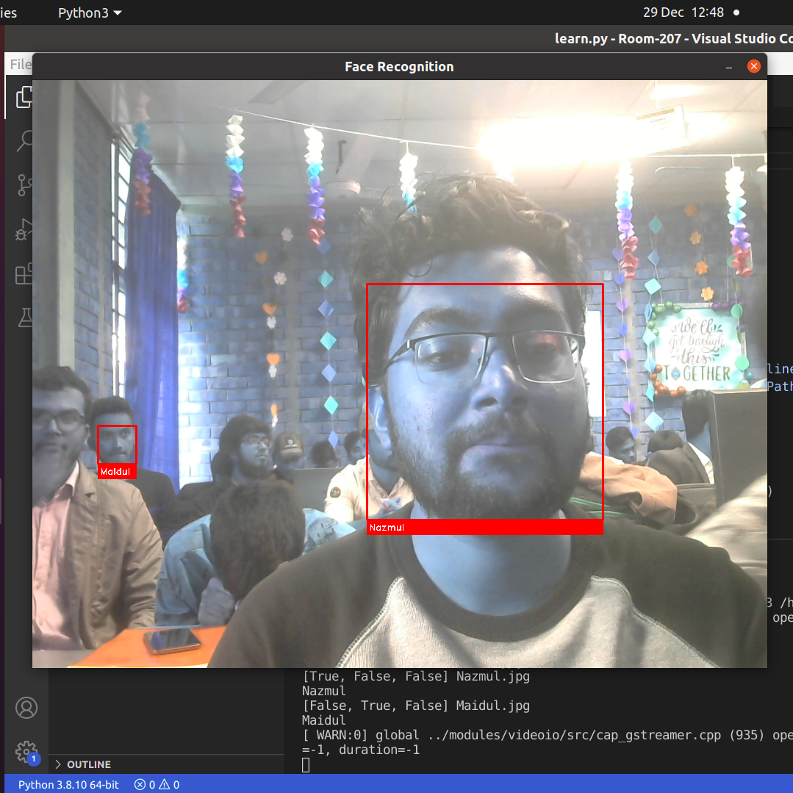

Slide 11
Learning and experience
How academic studies helps us to understand what we have to face in industry.
My problem solving experience helps me a lot in this project.
How a big problem can be solved by dividing the problem in efferent parts.
This project was a bright stair to success in Software Engineering Career.
Manarat International University
9

Slide 12
Thank You !
Manarat International University
10

